Slide 1
Project 1
Group 7:
Kendal Bergman, Joanna delaune, Aaliyah lockett, greg Michalak, evan sprecher

Slide 2
Purpose and Scope
The kind of data you’d like to work with and the field you’re interested in (finance, healthcare surveys, etc.)
Healthcare, specifically Covid-19 data
The questions you’ll ask of the data
Which states spent ARPA money on vaccination programs, and how much/how many programs?
How does vaccination grant spending compare to vaccination rates in each state?
Source for the data
EARN SLFRF Workbook, Q4 2022 (ref https://www.epi.org/resources/budget/)
CDC Covid-19 Data:
https://health.google.com/covid-19/open-data/
What this project is
Timeframe: post March 11, 2021 – end of 2022
All US states for spending summary. Then narrow to top 3 and bottom 3 in analysis (can change depending on time needed for analysis)
What this project is not
(Reference data constraints and assumptions list)
Data source constraints and assumptions
State size/population not taken into account
Different qualification criteria per state
…
Notes:
Example)
“The aim of our project is to uncover patterns in credit card fraud. We’ll examine relationships between transaction types and location, purchase prices and times of day, purchase trends over the course of a year, and other related relationships derived from the data.”

Slide 3
Data Source(s)
CDC - "COVID-19 Vaccinations in the United States, Jurisdiction"
https://data.cdc.gov/Vaccinations/COVID-19-Vaccinations-in-the-United-States-Jurisdi/unsk-b7fc
csv downloaded 5/11/23
EARN/EPI - "EARN SLFRF Workbook for Q4 2022" compiled by Dave Kamper of the Economic Policy Institute (dkamper@epi.org) from Treasury reports by states and local jurisidictions who received funding, and other data sources as detailed in the workbook.

Slide 4
Analysis Methods
The analysis process can be broken into two broad phases: (1) exploration and cleanup, and (2) analysis.
Describe here how we plan to answer the questions laid out in our Purpose section.
Ex) Summarize first, then narrow scope.
“We recommend focusing your analysis on multiple techniques, such as aggregation, correlation, comparison, summary statistics, sentiment analysis, and time-series analysis.”

Slide 5
Github Repo
One person to own the repo (Evan volunteers)
Make sure local repos are always up-to-date with the github.com repo
Pull each time you work on your portion
Commit all local changes and push to github repo when done working
Tip from William: Use a single .ipynb file for the project. Each person will pull that into their local repo.
Section off your code section with blocks #--------------------------- so that you have clear areas of work to prevent merge issues per line of code.
See https://docs.github.com/en/issues/organizing-your-work-with-project-boards/managing-project-boards

Slide 6
Project Proposal
Project Title
Covid-19 Vaccination Rates by State Federal Funds Usage
Team Members
Group 7
Project Description/Outline
Analyze dataset of all projects reported as of December 2022 that used the State and Local Fiscal Recovery Funds (SLFRF) that were allocated for state and local governments under the American Rescue Plan Act of 2021 (ARPA) to support governments during the COVID-19 pandemic.
Some states have committed and/or spent almost all of their money, while other states have committed and spent almost no money.
This project will look specifically at which states (and local governments in those states) used SLFRF funds for vaccination programs, and compare overall COVID-19 vaccination rates as of December 2022 in those states to vaccination rates in states that did not do so. Research Questions to Answer
Which states spent ARPA money on vaccination programs, and how much/how many programs?
Compare vaccination grant spending to vaccination rates in each state.
Datasets to Be Used
EARN SLFRF Workbook, Q4 2022 (ref https://www.epi.org/resources/budget/)
https://health.google.com/covid-19/open-data/
Notes:
Correlate in scatter if able.
Map rates by states with geoViews library
Review if we can call any of the google data from an API for the bonus criteria.

Slide 7
Breakdown of Tasks
Split presentation deck into six parts: each group member to speak during presentation
Evan: Data collection, write pseudo-code for .ipynb file, API bonus work
Sarah: Data clean
Greg: Google data collection and cleaning, Debug, technical issues, overall support, CDC API (where able/if has time to set up)
Aaliyah: overall support, Data collection from EARN workbook. Combination bar/line graph.
Kendal: Visuals planning and execution
Joanna: Visuals planning and execution, data interpret for EARN workbook.

Slide 8
Tasks due by EOD Monday
Split presentation deck into six parts: each group member to speak during presentation
Kendal and Joanna (visuals team): Review Greg’s dataset, plan all output visuals, request data needed from the data collection/clean team.
Aaliyah/Sarah/Evan (data team): Import and clean data from the EARN workbook. Provide output dataframe that will be able to compare % federal funding used per state.
Evan: Merge Greg’s branch and confirm his worked captured. More pseudo code.
Greg: Add comments into your codework. Source where applicable, otherwise succinct explanations for each cell where ambiguous. Support others as available.
Aaliyah: Create slide that briefly explains our measured inputs (% federal funding per state) and measured outputs (% population vaccinated per state and any other outputs built by data viz team).
Include a few sentences describing scope of data, data constraints and any assumptions made during analysis. This is more of a team effort due to each person working on their chunks.

Slide 9
Hypothesis testing notes
- Can we statistically test grant spending input vs. vaccine distribution rate output?
If so, how? T-test? ANOVA? How would you even test normality?
Output will need to be SUM of vaccines distributed at the end of our time range, per state.
Variable input is % of federal funding used (at end of time range). And Amount of $ spend and Count of projects (both per state).
Measured output is % of population vaccinated (1st dose) at end of time range, per state.
Constraints and assumptions for dataset: distance any given vaccine has to travel to get to end site. Method of transportation and how that may or may not affect vaccination rate. Political leanings! Do people think the vaccine carries 5g robots in the given state? Etc. etc. We can’t measure these variables on this scope and so our data analysis is HIGH LEVEL only. We need to showcase the methods we have learned in the class thus far.
Line correlation if able.

Slide 10
Development Requirements
Use Pandas to clean and format your dataset or datasets.
Greg did this in his Google_vac_data.
#TODO: Use similar methods in the EARN data.
Create a Jupyter notebook describing the data exploration and cleanup process.
#TODO: Add comments into Greg’s code. Source where applicable, otherwise succinct explanations for each cell where ambiguous.
Create a Jupyter notebook illustrating the final data analysis.
#TODO: Kendal and Joanna
Use Matplotlib to create 6 to 8 visualizations of your data
#TODO: Team/Kendal and Joanna
(ideally, at least 2 visualizations per “question” that you ask your data).
...
Save PNG images of your visualizations to distribute to the class and instructional team—and for inclusion in your presentation.
Save plots as variables and save into “Resources” folder.
Create a write-up summarizing your major findings. This should include a heading for each “question” that you asked your data as well as a short description of your findings and any relevant plots.
Bonus Use at least one API—if you can find one with data pertinent to your primary research questions.
#TODO: Take a csv table or columns and do the same using an API.

Slide 11
Tasks due by EOD Tues 5/16
Split presentation deck into six parts: each group member to speak during presentation
Evan/Aaliyah: Do combination bar/line chart for EARN workbook (to give us an idea of $ volume vs. %spend per state)
Evan: from Kendal’s dataframes, look at the top 3 or 4 states for which states had the highest vaccination rate. Then, from the EARN dataframe do grouped bar charts which show count of covid project types for those 3 or 4 states. Limit to top 4 project categories per state to keep clean visual. Or by dollar value spend per category. This will follow the slide on %
Kendal: Start moving plots into the presentation slide deck. Help organize the analysis showcase section.
Aaliyah: finish summary dataframe per slack message item (1) requested by Joanna.
Greg: needs Aaliyah’s dataset to finish correlation/regression plots.
Joanna: Help fill out this presentation slide deck- pull figures or help with the bullet points.
All: Align on slide deck and presentation. Run through slide deck as group to make sure we hit all the project requirements, 10 min limit.

Slide 12
Presentation Requirements
Questions that you found interesting and what motivated you to answer them
Where and how you found the data you used to answer these questions
The data exploration and cleanup process (accompanied by your Jupyter notebook)
The analysis process (accompanied by your Jupyter notebook)
Your conclusions, including a numerical summary and visualizations of the summary
The implications of your findings: what do your findings mean?

Slide 13
Covid-19 Spending vs. Vaccination Rates
Change this title if you can think of something better or if our analysis changes…
Group 7:
(names in alphabetical order here)

Slide 14
Questions that you found interesting and what motivated you to answer them
Did states that spent a higher percentage of their federally-granted budget have higher rates of vaccination?
Did states that spent a higher total $ amount of fed budget on COVID projects have higher rates of vaccination?
Did states that had more vaccine-related projects (count) funded by fed have higher rates of vaccination?
What Covid project categories did higher vaccination rate states initiate? (top 4 per state)
Were there similarities in project categories between these high vaccination states?

Slide 15


Where and how you found the data you used to answer these questions
CDC - "COVID-19 Vaccinations in the United States, Jurisdiction"
https://data.cdc.gov/Vaccinations/COVID-19-Vaccinations-in-the-United-States-Jurisdi/unsk-b7fc
csv downloaded 5/11/23
EARN/EPI - "EARN SLFRF Workbook for Q4 2022" compiled by Dave Kamper of the Economic Policy Institute (dkamper@epi.org) from Treasury reports by states and local jurisidictions who received funding, and other data sources as detailed in the workbook.

Slide 16
Introduce/explain ARPA/SLFRF
Explanation of program
Some states spent almost all money, some spent almost none
Insert Bar chart showing state % overall spending (all projects) here
Insert Kendal’s pie chart of project categories here or in next slide if this gets too busy.

Slide 17
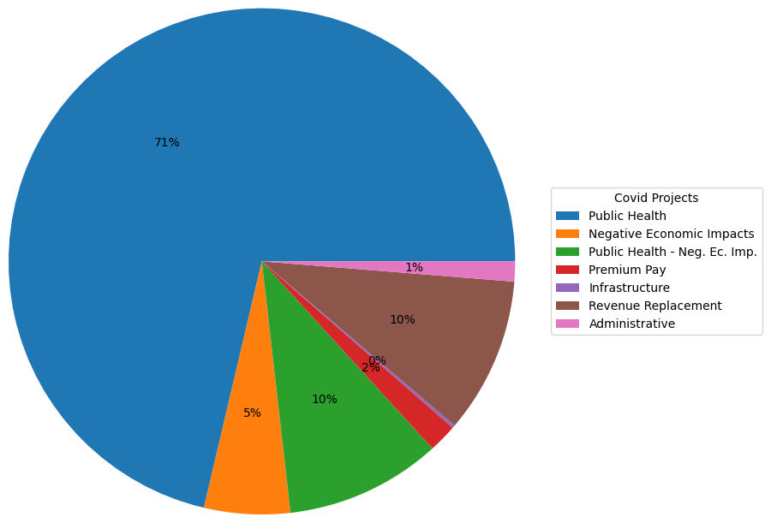
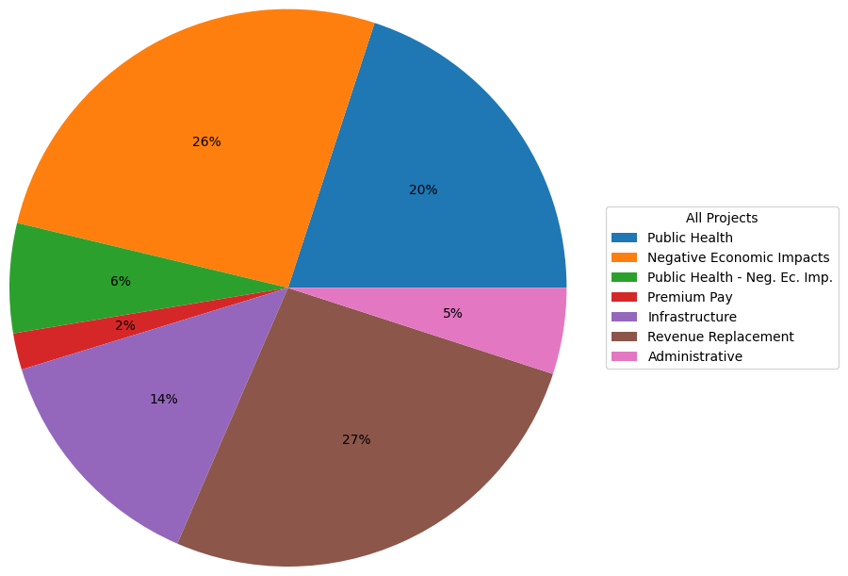
Spending Categories – Vaccine Programs vs. All

Slide 18
Key Questions
Motivation:
EARN workbook provided project funding per state/local gov’t during Covid-19 pandemic. (list date range here)
Some states spent almost all of their federally allocated budgets where others spent next to none.
This unique dataset allowed us to target states for deeper review based on their percentage spend of federal funds allocated. (mention pulling CDC data here?)

Slide 19
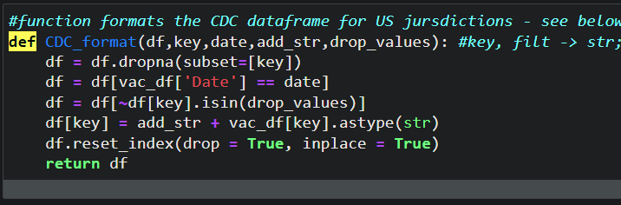
Data exploration and cleanup
Methods:
Import raw data as csv
Drop rows with NA values
Clean column values with string replace functions
Cast strings as numeric where needed
Pandas groupby to sum or count values
Created reduced DFs for specific visuals
Created calculated percentage columns within relevant DataFrames
Defined functions: DRY!

Slide 20
The analysis process
!! We can drop this slide after the analysis plots are in their respective slides
Here’s where we show, don’t tell:
Slides showing state heatmaps.
Then bar charts for categories by state (spending or count of charts for top 3 or 4 vaccinator states).
Then what?? At least 1 correlation/regression plot? Would be moreso to showcase our ability to use the method.

Slide 21
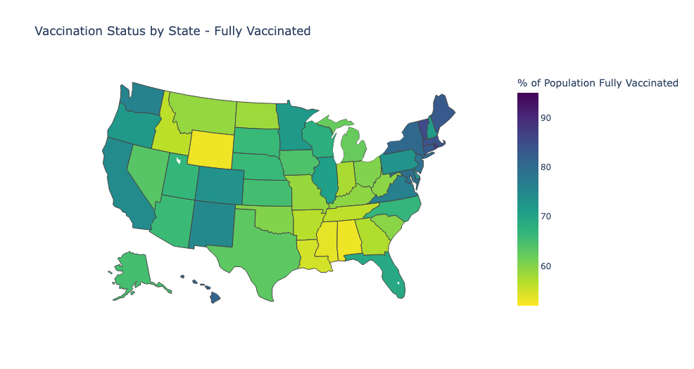
Vaccination Status by State
Mean – 68% (WI)
Min – 53% (AL)
Max – 87% (RI)

Slide 22
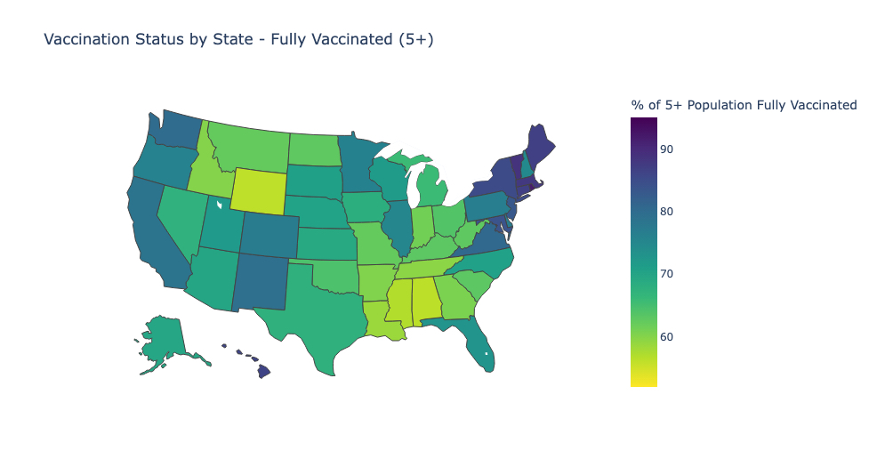
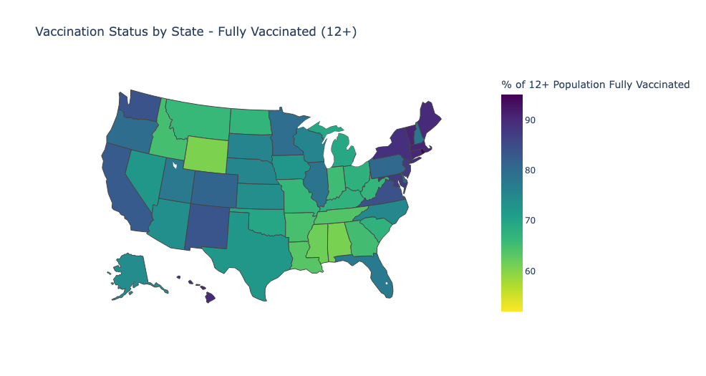
Vaccination Status by State – Age Groups
Ages 5 and up
Ages 12 and up

Slide 23
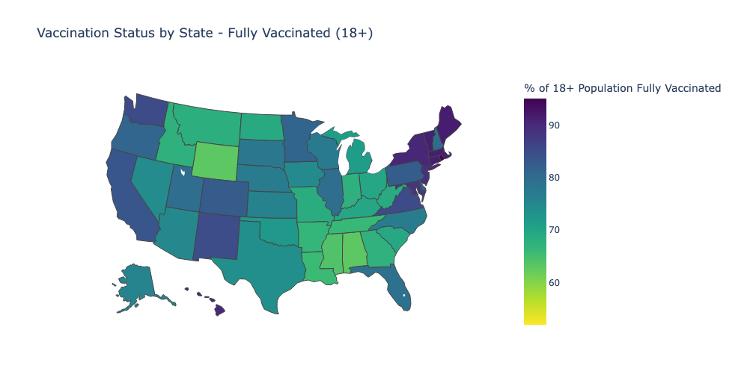
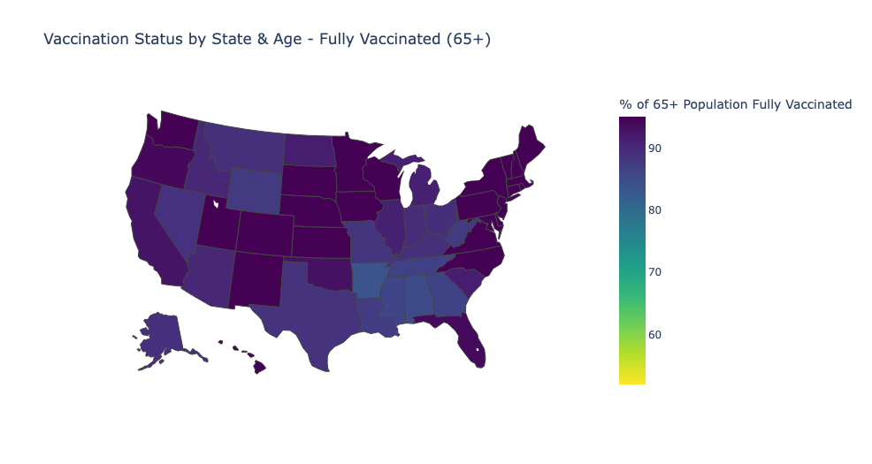
Vaccination Status by State – Age Groups Continued
Ages 18 and up
Ages 65 and up
Notes:
Min/Max for 65+ is – 84%-95%; average of 65+ series complete across all states is 92%. Not a lot of difference in the numbers of 65+ people fully vaccinated by state. Does this hold true for the bivalent booster?

Slide 24
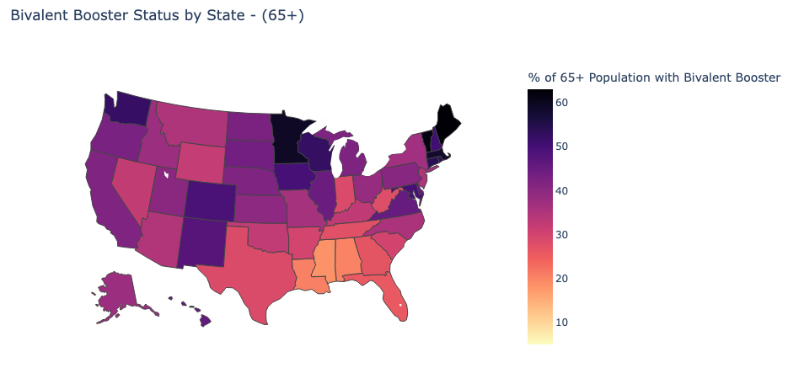
Bivalent Booster Status – 65 plus
Notes:
Unlike fully vaccinated, the highest percentage of 65plus folks we see with a bivalent booster is around 60%. The lowest percentage we see is about 18 percent in Mississippi, and the highest we see is around 62% in Maine. So overall percentages are lower, and there is a greater distribution of percentages across states (62-18, vs 95-84)

Slide 25
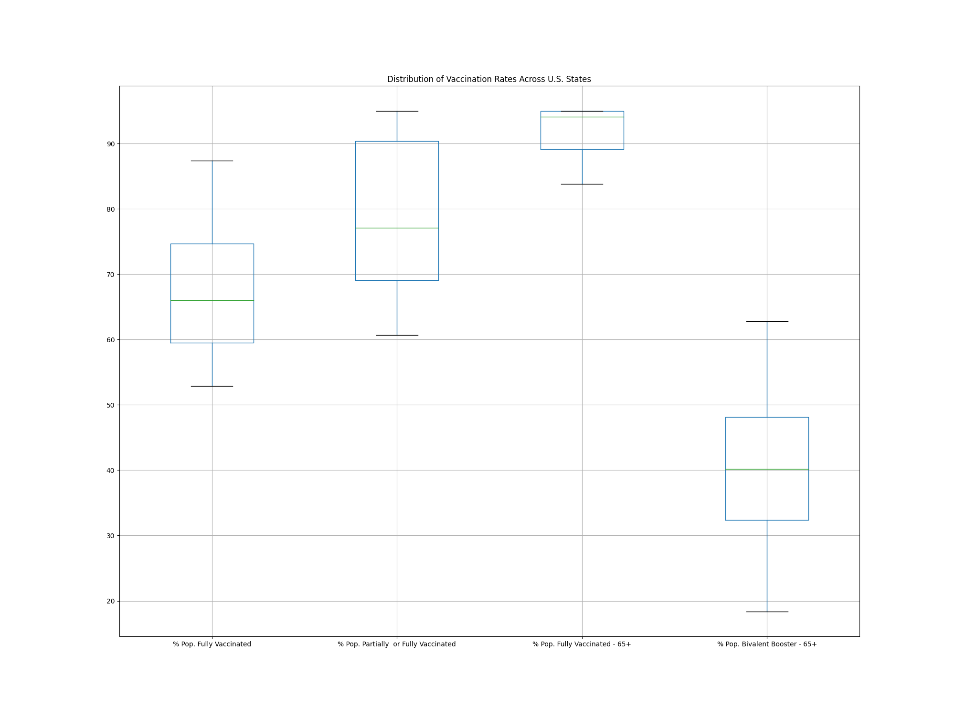

Slide 26
Correlation/Regression plots here. Pick the 2 most “interesting” plots.
Or whichever plots provide easiest talking point for the speaker.
Make a clear statement that there are many variables affecting the regression plots.

Slide 27
Your conclusions, including a numerical summary and visualizations of the summary
Joanna to pick the top 2 or three conclusions here.
Talking about what we did NOT conclude is great too! Or other topics that were out of scope of either the data set or our analysis.
Insert repeated copy of the most significant graphs from our analysis to bring the audience back to what was stated earlier in presentation. (if it helps)

Slide 28
The implications of your findings: what do your findings mean?
(We should put our slide deck together before filling this out because this will need to align with the outcome of our analysis and analysis conclusion presented).
(What would potential next steps be if this presentation was the “scoping phase”) This will depend on our individual conclusions, really.

